Slide 1
GETTING STARTED USING OpenCPN
OpenCPN is an advanced, marine navigation software program, available to both the recreational boater and the professional captain.
Through a NEMA 0183, serial interface and serial to USB adapter, OpenCPN interfaces GPS and AIS data to your computer.
Other features include exporting routes for transfer to other GPS devices.

Slide 2
America’s Boating Club-Knoxville
DISCLAIMER One: This free seminar is in no way intended to teach you even the basics of marine navigation or electronic navigation!
It assumes that you have thoroughly mastered Piloting and preferably Advanced Piloting or are a competent and experienced marine navigator!
Any errors, omissions or misstatements of fact are not the responsibility of ABC-K or the presenter.
Only study and comprehension of the FULL OpenCPN manual can facilitate the usefulness of this free, open source software.

Slide 3
America’s Boating Club-Knoxville
DISCLAIMER 2: WE HAVE ELECTED TO USE OPENCPN, A FREEWARE, OPEN SOURCE CHARTPLOTTER SOFTWARE AS AN EXAMPLE OF CHARTPLOTTER CAPABILITIES SO EVERYONE IN CLASS WILL HAVE A COMMON DISPLAY .
There are certainly other sources of chartplotter functionality available but OpenCPN will let you learn the basics in a common, classroom environment which facilitates learning.

Slide 4
Learning New Software/Hardware
Often learning to use new software or electronic hardware can seem overwhelming at first.
Seeing a “Quick Start” overview will let you grasp basic functionality so you have an idea of what to expect.
Being exposed to some of the many capabilities will get you started so you can begin learning easily/quickly.
We are presenting an overview of electronic river navigation here.
Your chartplotter may have different icons but probably similar functionality.

Slide 5
OpenCPN Section 1 Waypoints and Routs
Learning objectives:
Understand the two sets of Icons used in Version 5.0
The effect of ZOOMING in or out
Dropping WAYPOINTS
Waypoint properties and naming conventions
Building ROUTS
Route properties
Printing routs for reference
Exporting Routs as GPX files for other devices
Changing existing Routs

Slide 6
OpenCPN Help and Questions
The most frequently asked questions, by new users and seen in the OpenCPN Forum, are, in most cases, already answered in the OpenCPN USER MANUAL (https://opencpn.org/wiki/dokuwiki/doku.php?id=opencpn:opencpn_user_manual).
If you are going to use this program for actual navigation, you need to read through the user manual to fully understand the scope of the program, as well as all the details for GPS and AIS installation.
If you have difficulties finding a particular subject, please use your browser's built-in search ability, often called just “Find”. This works best using the stable release which will be all on one web page.

Slide 7
In-Program Help
In “OpenCPN” itself, just press and then Help, near the bottom of the insert, to access the built-in version of the user manual.
The installed documentation will open in your default Internet browser.
This is the first place to go for help and please carefully read the documentation!
Also the latest OpenCPN User Manual can be downloaded as compressed HTML files and directories from the website.
You will need to uncompress them into a new folder and use your browser to access the help files.

Slide 8
Example OpenCPN Help Index
Getting Started
OpenCPN Instillation
Windows
GPS Setup
Chart Installation
Settings Options
Marks and Routs
Getting Around
GPS Setup
Display orientation
Chart info
Charts
Options settings

Slide 9
OpenCPN Help Explained
To help you get started with help:
Links are internal to user manual. Placing your cursor over a link will cause the link to be underlined.
External links may be Bold, Underlined, or in the “http:/\…” format and you will need an Internet connection these so learn it at home or on the dock.
Marks and Waypoints may have somewhat different definitions; however, in this document they generally mean the same thing.

Slide 10
You Need Other Courses
The OpenCPN User Manual is not a text on marine navigation!
It assumes that once using it on the water, you are familiar with marine navigation.
Reading this text and using OpenCPN will not in itself make you a “navigator”.
The America’s Boating Club: Marine Navigation (Piloting) and Advanced Marine Navigation (Advanced Piloting) are the two courses that teach marine navigation within sight of land.

Slide 11
Concord YC Area, Zoomed out
<=Icons 1
Icons 2 =>

Slide 12
Icons (1) explained
<= Hide / show this icon bar
<= Options settings
<= Route create
<= Route Manager
<= Trails enable / disable
<= Day or Night screen mode
<= Print the displayed chart
<= About & questions
<= World Magnetic Variation Corrections
<= Drop Man Overboard Marker
Notes:
Create Route will allow you to move the pointer from point to point and a click at each point will drop a waypoint.
Tools will be discussed later.

Slide 13
Options Icons(1) “General” from GEAR Icon
Select options as shown left, (set speed to 6 Knots) then click “Apply” and next click “OK”. (Note Smooth Panning / Zooming uses your mouse and may be erratic and hard to control!)
Then =>
<=First
Notes:
The options display allows us to select various options for the Display – for now, select those you see here.
At the bottom is your selection of your normal boat speed – for now use 5 knots.
We will use the charts icon later.

Slide 14
Options Icons(1) “Units”
For Inland/River set to Statute Miles, Mph and Feet. Plus show True Bearings and Headings. Then click “Apply” and then “OK”.
Notes:
Set these options as shown for this course.

Slide 15
Options Icons(1)
ENC & RNC CHARTS Installer and options plus setup
Setup GPS & AIS CONNECTIONS/interfaces
Change SHIPS Icon
Modify USER INTERFACE, display options
Install PLUGINS, later, as needed
Statute miles
Mph, Inland
Notes:
These other option Icons can be used later to install other charts, etc.

Slide 16
Chart Display Options
Select
Light/dark water
boundary based on
next lower depth
contour, 9’ here.

Slide 17
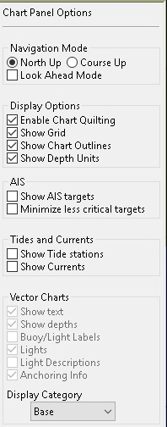
Zoom – Scale, Icons (2) lower right “Chart Panel Options” show/hide Set Display Category to “BASE” & check boxes as shown =>
Z
o
o
m
I
n
You need “Chart Quilting” for buoys and “All” instead of “Base” may help.
Zoom Out
Follow ship position, later
<= Click Options
Notes:
Zooming In and Zooming Out shows a larger or smaller area of the chart.
“Follow ship position” works with GPS input on the water later.
The options “Hamburger” hides / shows the Chart Panel Options.

Slide 18
Concord YC Detail, Zoomed in

Slide 19
What this page tells us
Arrow below shows
North up mode
<=Red satellite
shows no GPS
input
Depth in Ft.
Land and land
features
Sailing line=>
<=Num buoy
Details about CYC =>
by right clicking on it.
<=Can buoy
=>
<=Mooring buoys
Deeper water,
lighter
Shallow water,
darker
SOG = 0, COG = ___ Latitude & Longitude at curser

Slide 20
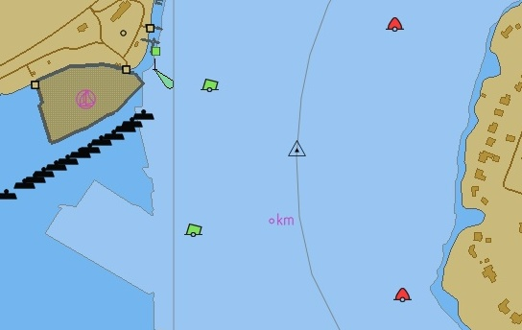
Marks and Waypoints
Marks or waypoints are location markers on a marine chart that you have placed to assist in navigation.
At the curser location, right click and select drop mark.
See the default, triangle,
mark symbol on the
Sailing Line near Concord
Marina.
Right click on the mark
and select properties.
<=Waypoint
<=River Mile

Slide 21
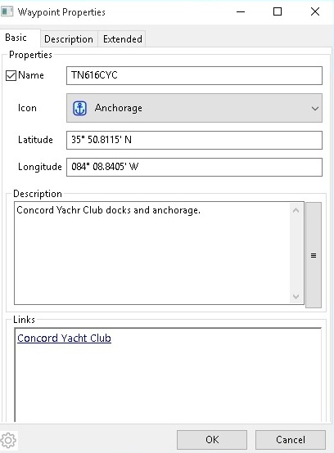
The Waypoint Properties Box
Waypoint names will be in alphabetical order in lists.
<=Name River, Mile & Location
<= Change the symbol
Add a description if needed.
<
Add a website link so you can go directly there if you have Internet access.

Slide 22
Another suggested waypoint
Now all the display items are turned ON now so you see mile markers, text and shore features.

Slide 23
A safe harbor for storm refuge

Slide 24
Waypoint for Ft. Loudon L & D
I could not find a lock & dam icon so I used Bridge 1.

Slide 25
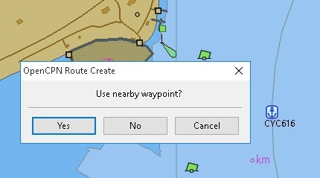
To Build a Route
Click on the Routes Icon and it will display a pencil.
To use an existing waypoint in a route put the pencil point on it and click it.
The software will ask
if you want to start with
or use that waypoint in
your route and here
we click yes.
You can start your route at any arbitrary location.

Slide 26
Continue route dropping other marks

Slide 27
Approximate Route
Does not closely follow “Sailing Line” so actual 13 miles shows as 12.7.

Slide 28
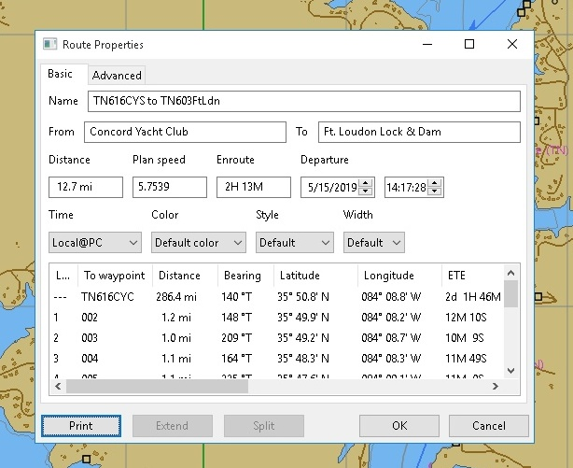
Enter Route Properties
Right click route line (not a waypoint) and the route properties box opens so you can enter data and save it. Route = 12.7 miles, 2:13 at 5.8 mph.

Slide 29
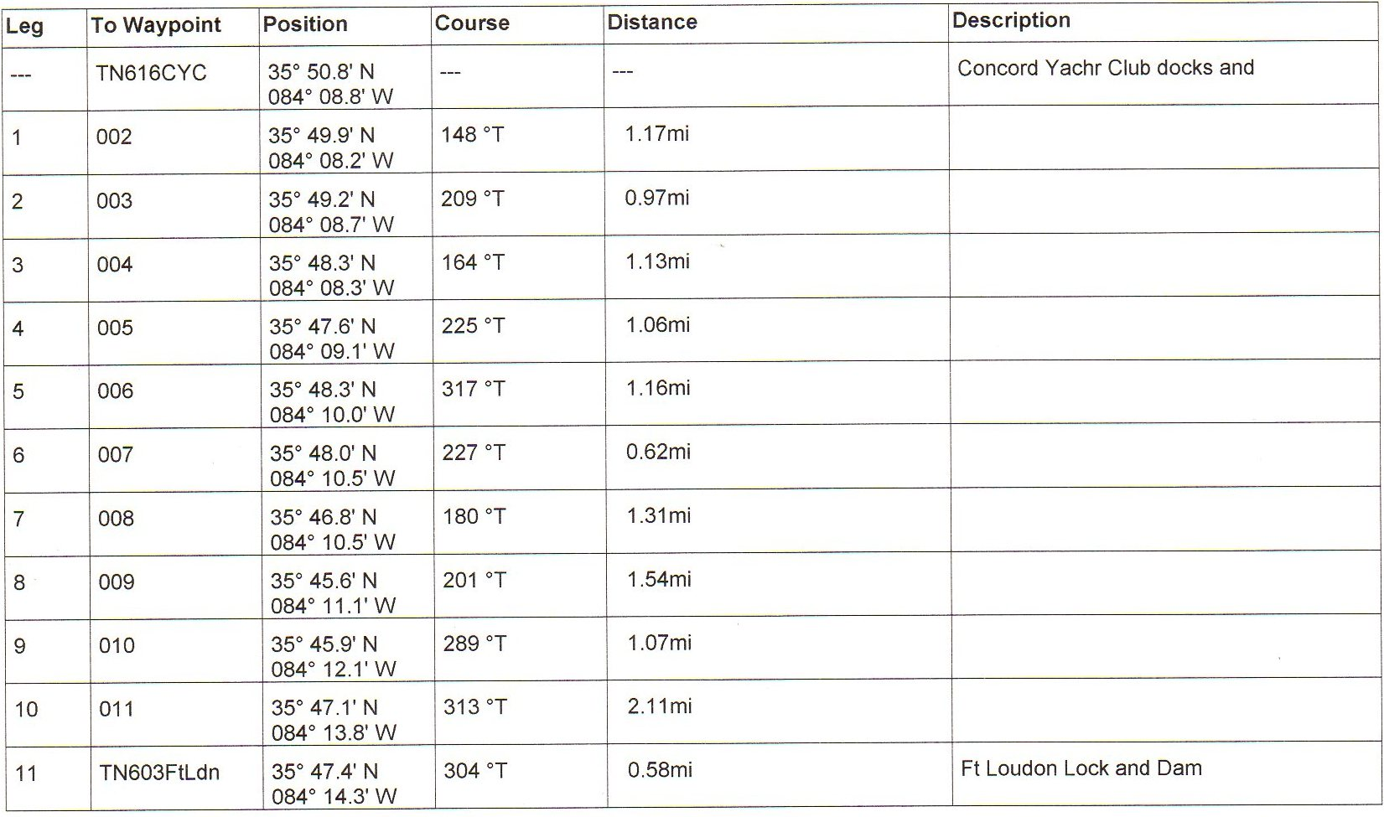
Printed Route Properties so you can check your progress
ROUTE WILL START WHERE SHIP ICON IS LOCATED.

Slide 30
Routs can be exported as GPX (XML Data) interchange files
This short route took six pages when converted to a text file.

Slide 31
Route right clicked to highlight it in orange. Route change and other options shown. You can run this route forward or REVERSE.

Slide 32
Section 1 What We Covered
Learning objectives:
Understand the two sets of Icons used in Version 5.0
The effect of ZOOMING in or out
Dropping WAYPOINTS
Waypoint properties and naming conventions
Building ROUTS
Route properties
Printing routs for reference
Exporting Routs as GPX files for other devices
Changing existing Routs
Any questions before we study on water navigation use?

Slide 33
Section 2 Using OpenCPN for on the Water Navigation
Learning objectives:
Is your GPS working properly
Do you want text
Chart options
Additional options for navigation
Day Vs night display mode & F6 key dimming
Look ahead for more information
AIS targets
Leader length
Rings
Enabling tracks
Sailing a Track and ETA
ATONS and other landmarks

Slide 34
Checking your GPS input
The black Boat Icon will turn red when your GPS input is functioning.
Click on the Follow (boat & red circle icon) above and the display will follow your boat location and direction
(based on your COG).

Slide 35
Do you want TEXT turned on?
When Zoomed out TEXT is distracting but once you zoom it provides additional useful information.

Slide 36
Chart Display Options
Here you can customize your chart display to match your needs on a particular cruise.
There are a LOT of options but you can Reset to STANDARD.
You need to APPLY your selections before you OK.

Slide 37
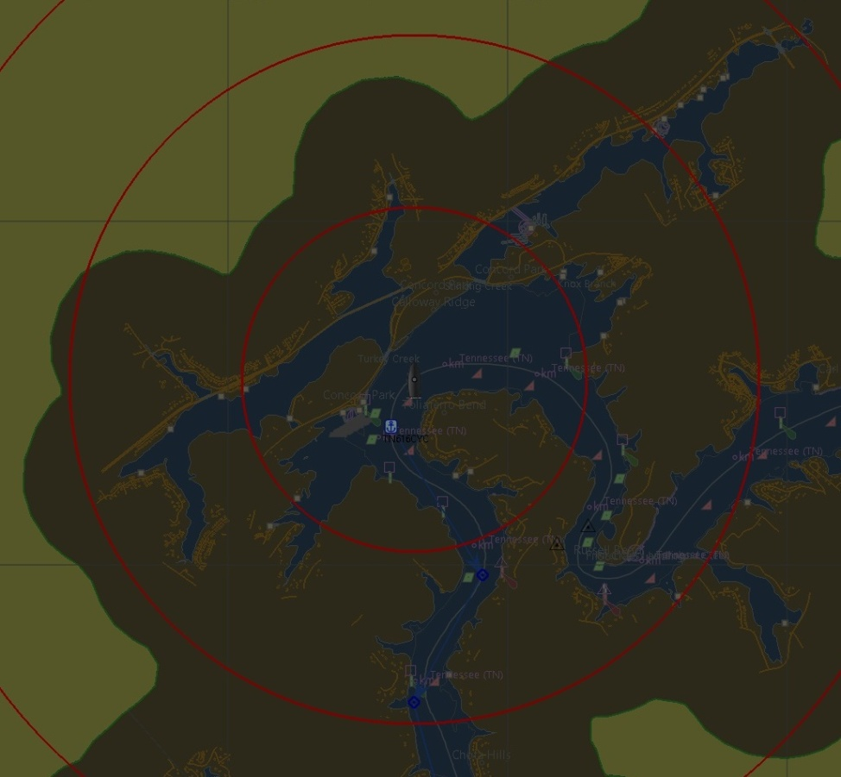
Day Vs Night Display Modes
Switching from Day to Night Mode using the Day/Night icon.

Slide 38
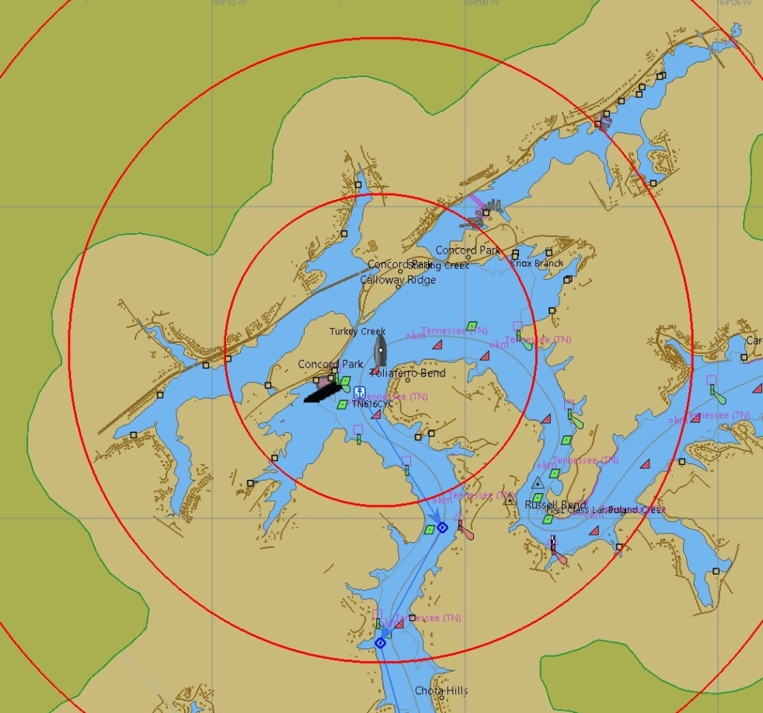
10 Level Screen Dimming w/F6 Key
MAX Vs MIN

Slide 39
Look Ahead and Other Options
COURSE UP orients the chart to your COG.
LOOK AHEAD shows 2/3 chart ahead and
1/3 aft.
CHART QUILTING is needed to display buoys.
SHOW GRID displays L and Lo lines.
CHART OUTLINES shows the charted area
outlined.
SHOW AIS TARGETS shows other AIS
equipped boats with its GPS predictor.
SHOW TEXT turn Text on or off.

Slide 40
GPS Predictor and AIS
GPS Predictor set to five minutes.
Any AIS equipped boat, in range would also show a GPS predictor so you can anticipate where you will meet/pass.

Slide 41
Other Ship SETTINGS Options
Gear Icon > Ships and don’t forget to Apply before clicking OK on all of these.
SHIPS
COG Predictor length set to five minutes.
Four rings with 1 mile spacing colored red.

Slide 42
Enabling Tracks to Record frequently traveled routs
If you click the TRACK Icon so it dims, as shown,
the software will record and display your TRACT (trail) of where you have sailed.
This is a good way to get an accurate route that you travel frequently.
Stop and save the TRACK and them convert it to an accurate route for future use.
Be sure to record in the middle of the channel so you can then run the route in Forward or Reverse.

Slide 43
Activating a Stored Route
Routes in alphabetical order.
Highlight route and select reverse if needed and then ACTIVATE.

Slide 44
Sailing an Activated Route
The route has now changed from blue to red (Active) and the next waypoint is highlighted in Yellow with a Red ring.

Slide 45
ETA to End of Route
The Red Circle shows no GPS input.
If we had a GPS attached it this popup sidebar would show an ETA to the end of the activated route.
Here you see the bearing to the first waypoint.
You can automatically enter a route at a midpoint just be activating when you are near the route, moving in the correct direction.
A Zero ETA indicates not moving or moving in the wrong (REVERSED) direction.

Slide 46
ATONS and Curser “Pick Report”
Launch Ramp
Can buoy
Lighted Daymark
Object Query
“Pick Report”
Right Click
Nun Buoy

Slide 47
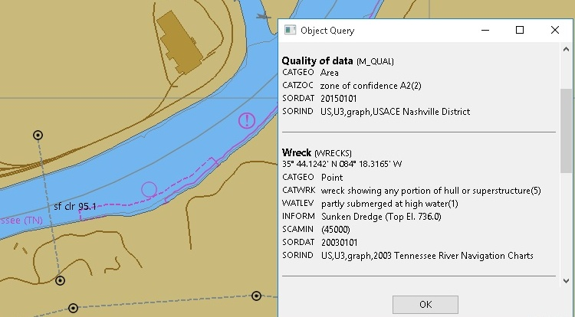
Wreck, Power Line Gauge
Gauge, often on Bridges
Wreck
Shore Building
Power Line
95.1 Min Clearance

Slide 48
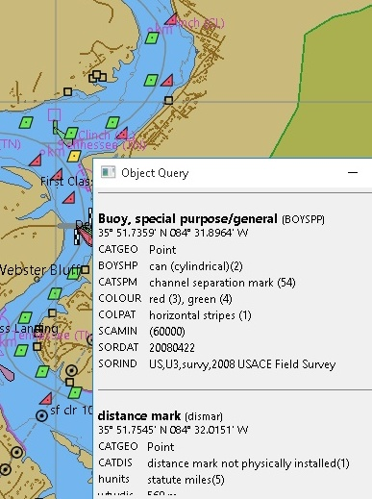
I 75 Bridge & Junction Buoy
Bridge
Junction
Buoy ,TN &
Clinch River
Pipeline
No Anchoring

Slide 49
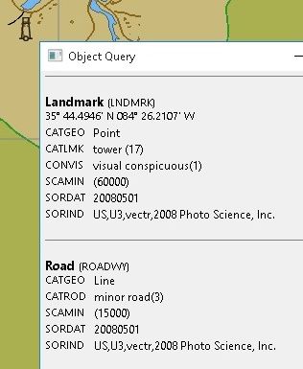
Caney Creek Marina & Tower
Tower
Caney Creek Marina

Slide 50
Section 2 What We Covered
Is your GPS working properly
Do you want text
Chart options
Additional options for navigation
Day Vs night display mode & F6 key dimming
Look ahead for more information
AIS targets
Leader length
Rings
Enabling tracks
Sailing a Track and ETA
ATONS and other visible landmarks

Slide 51
You can now use OpenCPN for:
Route planning at home and then send to your onboard Chartplotter via GPX file transfer on an SD Card.
Use on a laptop as an additional navigation device.
Use its AIS capability for safer navigation in congested or high marine traffic areas.
Use the Simplified Vessel Data Recorder (S-VDR) Plug-in to save your cruise information.
Explore other add on Plug-Ins like weather , etc.

Slide 52
Course Auditing
REMEMBER, THIS COURSE IN NO WAY MADE YOU A COMPETENT MARINE NAVIGATOR!
If you audited the course please, please:
Study Chapter 5 in an ABC3 book (to be removed soon).
Take Marine Navigation (Piloting) course and
Take Advanced Piloting (Advanced Marine Navigation).
This course showed how to use modern, marine navigation tools IF YOU ARE ALREADY A COMPETENT NAVIGATOR!

